Slide 1



KSC FABRICS HR DATASET
Presenter
TUMININU EGBOWON

Slide 2
Introduction
Data analysis entails giving insights to organizations to facilitate growth and improve profits, it also helps organizations’][;iu discover loss causing factors.
Here is a project I did improving on my effort to scale up in data analysis Data analysis basis and correctness is based on its cleaning.
Data cleansing is the process of analyzing the quality of data in a data source, manually approving/rejecting the suggestions by the system, and thereby making changes to the data.1. Data Cleaning 2. Data Modeling 3.Data Visualisation 4.Dashboard/Report.

Slide 3

Objective
Analyze Hr Data of KSC Fabrics Ltd and provide insights and recommendations based on plans for staff promotion. Company started in 2016,They have 80 staffs and their plan is promote every staff that has worked for 7 or more years.
3

Slide 4
SPECIFIC OBJECTIVE
- Analyze the HR Data
Draw insights and make recommendations for staff promotion
Spot Employees that have worked for 7 or more years in the company
Develop a plan to promote eligible staff members.

Slide 5
Insights
Job as an analyst is to bring forth useful observations to the business.
We discovered that the workers distribution falls between age 28-34 years, they are young adults, likely newly married or about to be married, many have just started having kids or have kids between 1-7 years, they are very much interested in the growth of their career and multiply source of income, finance is something that motivates them and they can easily travel or relocate.

Slide 6
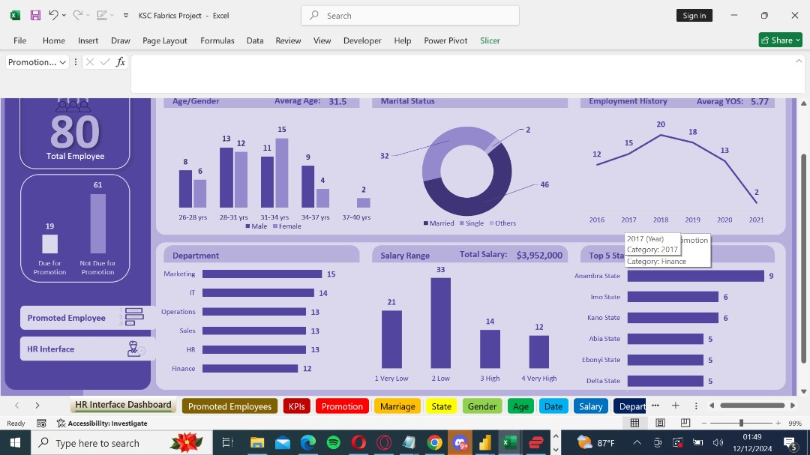
SALARY

Slide 7
Insights
A great percentage of the salary falls between very low and low and since KSC has a lot of young people working for them salary is a major factor in their decision making.

Slide 8
Insights
. 61 staffs have been working for the company less than 7 years.
. 19 staffs have been working for the company for 7 or more years.

Slide 9
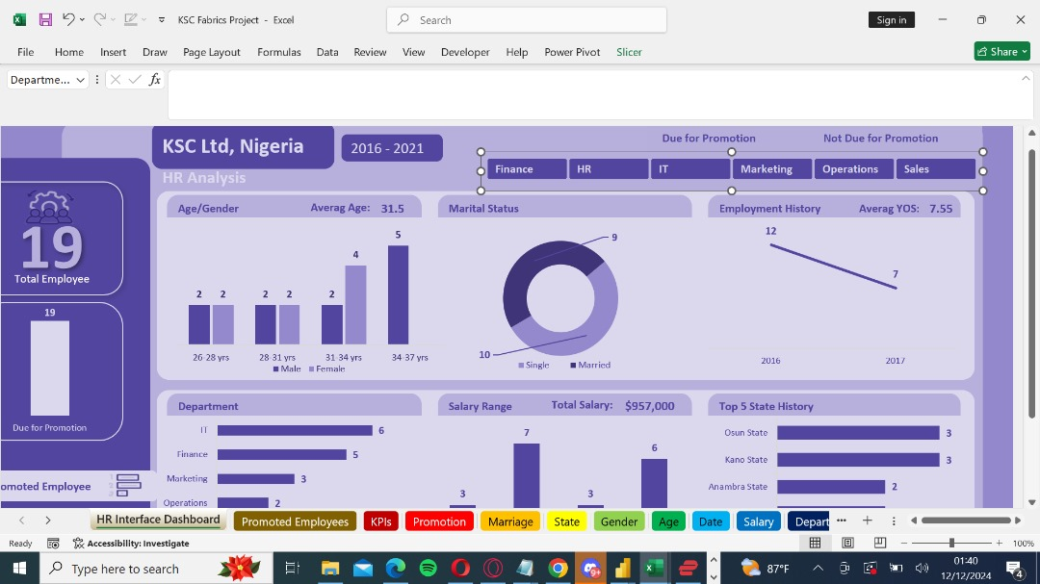
DUE FOR PROMOTION

Slide 10
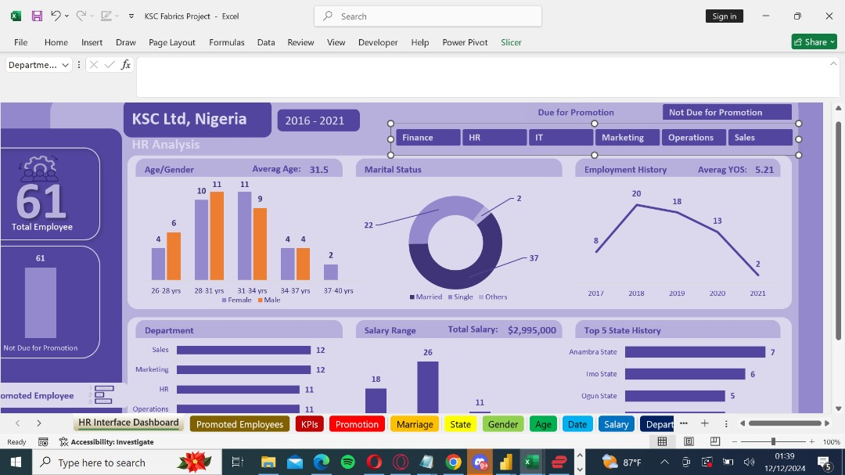

Slide 11
Recommendations
KSC fabrics should look at the industry and check competitors salary, if it is lower we recommend an increase in salary, if its the same add some incentives. Since the majority of workers are young people between 28-34 years they are eager for growth in their career, you can support their career by paying for their trainings and help them register for professional courses.

Slide 12
Recommendations
Promotion aspect,19 staffs are due for promotion and 61 are not due.
Promotion with time spent in the company might create some rift between departments in the company cause there’s a wide disparity between departments and some are having a good number of their department promoted whilst some have a very low number
And also we’ve a very high number of staffs from the Southern part of the country who would be due for promotion and that too could cause some frictions hence disrupting work balance and togetherness. The company is looking to create stability in workforce and an environment that is less toxic for all.
KSC fabrics should work on how to access performance individually. More concentration should be on the performance of the staff at his job individually. Its not about how far but how well.

Slide 13
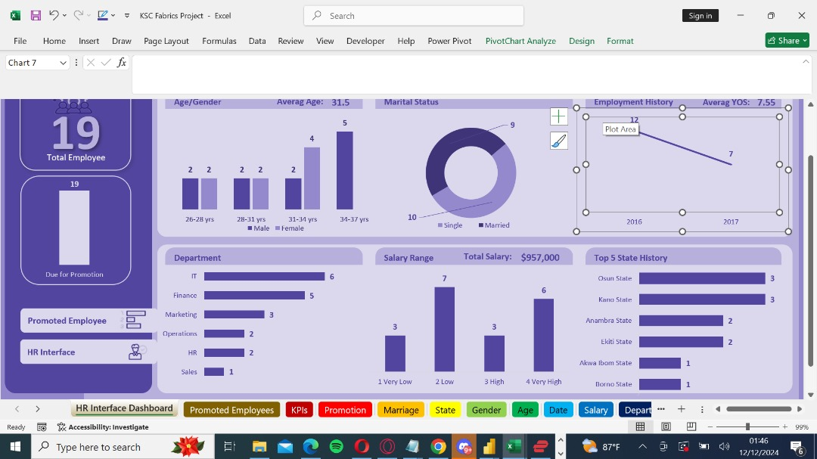
DEPARTMENT

Slide 14




Thank you
TUMININU FOR NUPAT TECHNOLOGIES

